Slide 1


Intelligent Object Detection and Interactions for Visually Impaired
In Python and Android, A Research Based Solution
Leeds Beckett University
Prepared by: Sujan Aryal
Std Id: C7190077

Slide 2
Introduction
It’s a AI Based System for Visually Impaired people.
There are two projects one in python with object detection and interaction
Another is a Android App called Blind Vision which consist of text to speech functionality.

Slide 3
Problem Statement
Living a healthy and quality of life is extremely challenging for the blind person.
If we discuss about issues that blind people face either in Nepal or abroad, the concern is applicable to both sides.
So to make the life simpler the implementation of AI to Aid such people is remarkable.

Slide 4
Project As Solution
Firstly, in this digital world, knowingly or unknowingly we are using AI in our day to day life.
Face detection, which is used in almost all smartphone cameras, is a well-known method of object detection.
This project looks at the development of Blind Vision, a mobile app as well as python project.

Slide 5

Aims and Objectives of Project
The aim of this paper is to apply an object detection technique to aid visually impaired since they have to face difficult problems in daily life.
This allows visually impaired people to know about the objects around them with the help of AI System. so they can walk independently.

Slide 6
Review of Technologies
Tensor-Flow: end to end open source platform for matching learning.(flexible ecosystem, tools, libraries and resources)
Open CV: highly optimized library which focus on real time apps (cross-platform i.e. suitable for various programming languages)
Label-Image: image annotation tool to generate xml from selected area(bounding box)
IDEs: Visual Studio code, python idle, sublime text.
CNN/R-CNN: Faster R-CNN (high accuracy and faster time)
Text To Speech: for reading text out loud.(useful for various apps)

Slide 7
Selected Methodology Waterfall Methodology
Clarifies a logical series of steps all throughout SDLC (system development lifecycle).
Each phase of the development can be compared with assumptions and thus verified.
Each phases closes with intermediate outcome.
The production cycle is easy to follow.
All the requirements required for the product can be gathered in starting phase.

Slide 8
The Architecture Of the System Use case Diagram
.

Slide 9
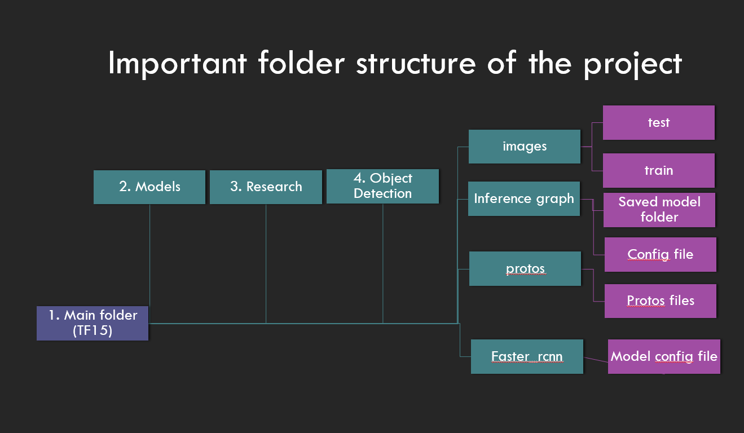
The Architecture Of the System Project Flow of Python App
.

Slide 10
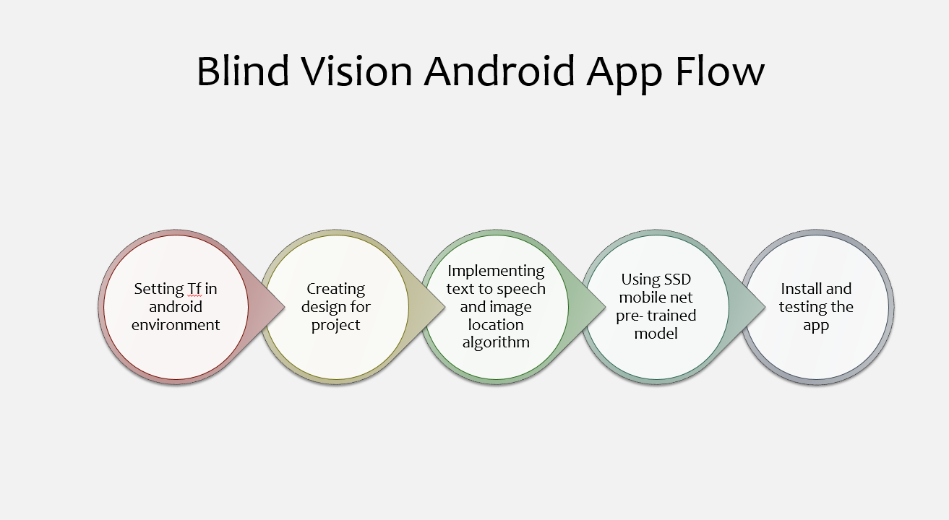
The Architecture Of the System Project Flow of Android App
.

Slide 11
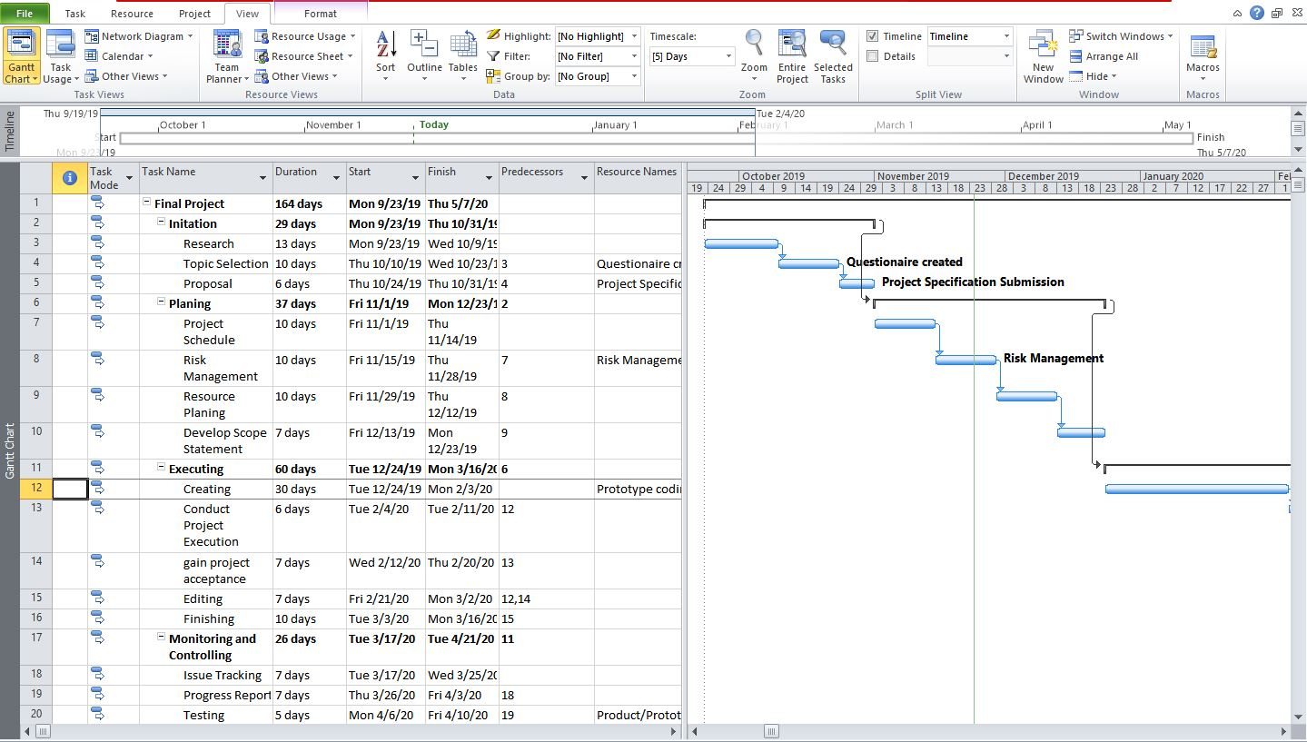
Gantt Chart Part 1
.

Slide 12
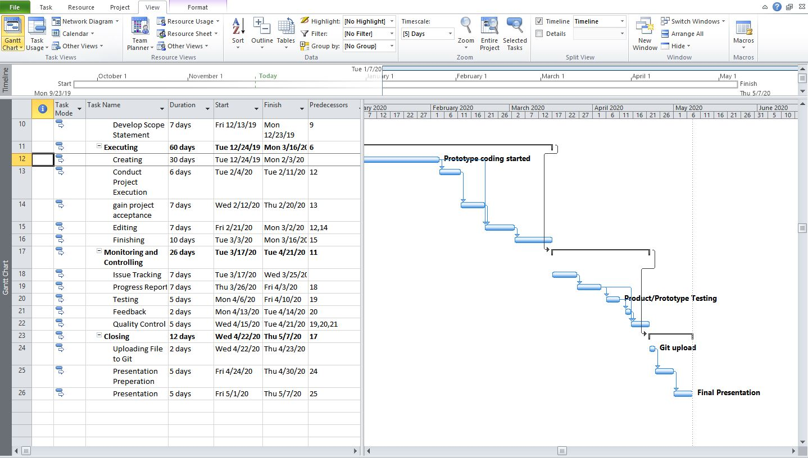
Gantt Chart Part 2
.

Slide 13
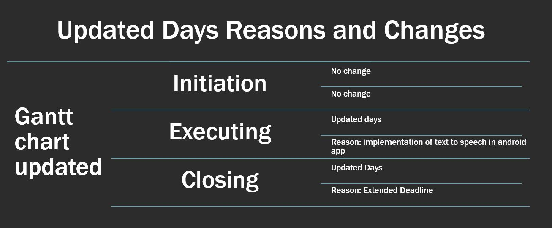
Gantt Chart Updated with Reasons
.

Slide 14
Features Of Both Systems with Product Evaulations
Python
can detect from image, video as well as real time with webcam.
Object detection along with it’s interactions.
Designed for visually impaired.
Android
AI system with real time object detection with voice feedback
Image location algorithms with simple navigations.

Slide 15
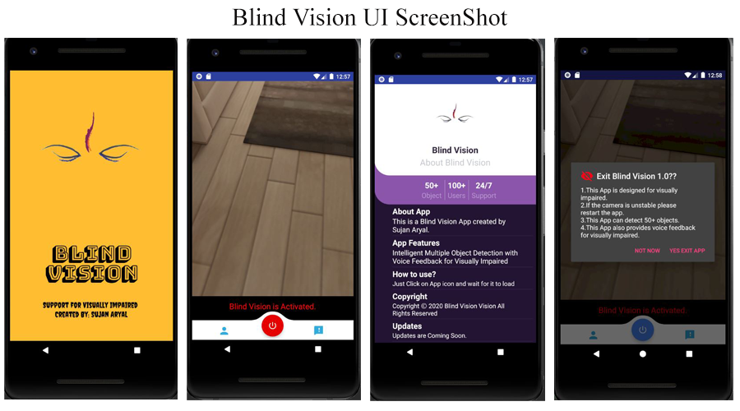
Some UI Designs

Slide 16
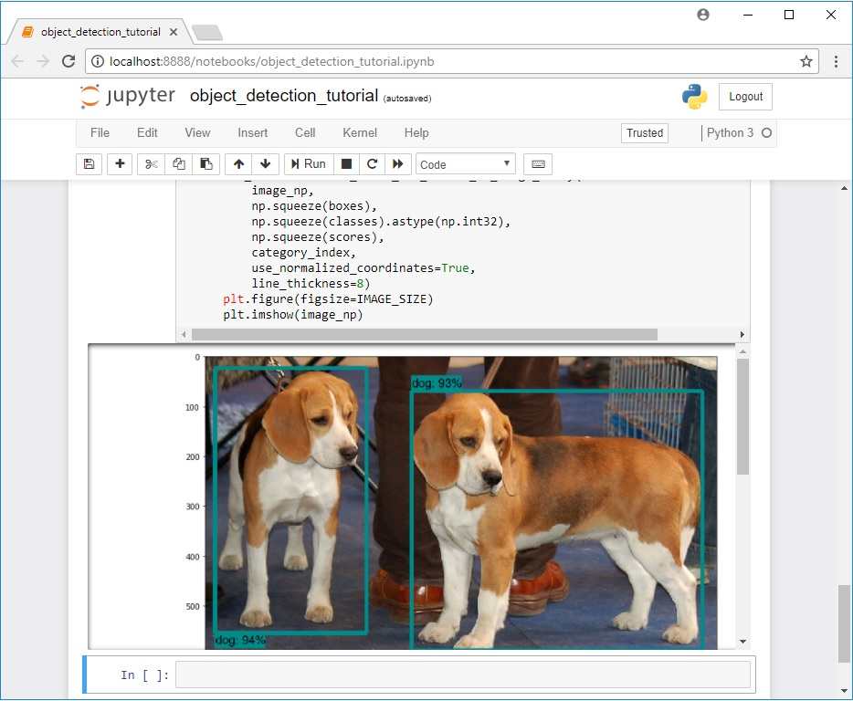
Testing the product
Tested the code in jupyter
Notebook.

Slide 17
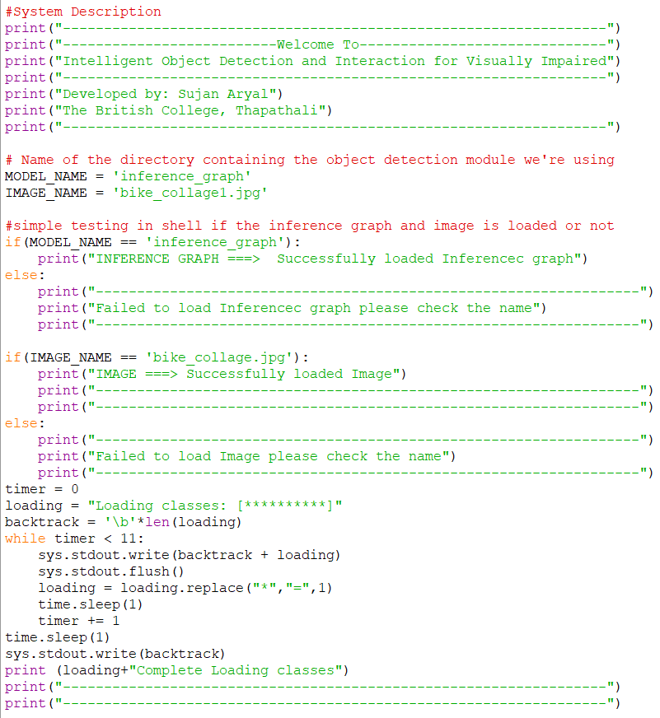
Testing the product
Testing small but important testable parts of the
system

Slide 18
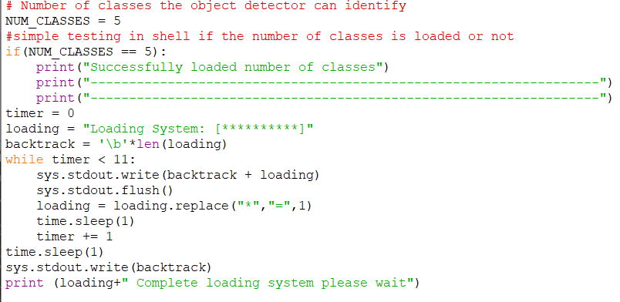
Testing the product
Testing small but important testable parts of the system

Slide 19
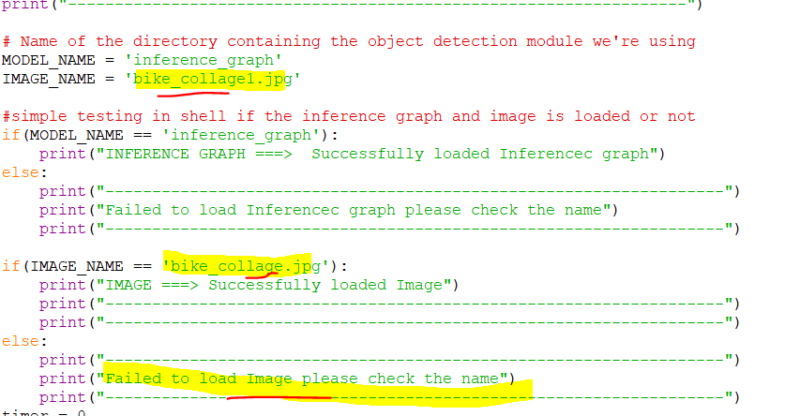
Testing the product
Added wrong image name to see if the testing is working or not

Slide 20
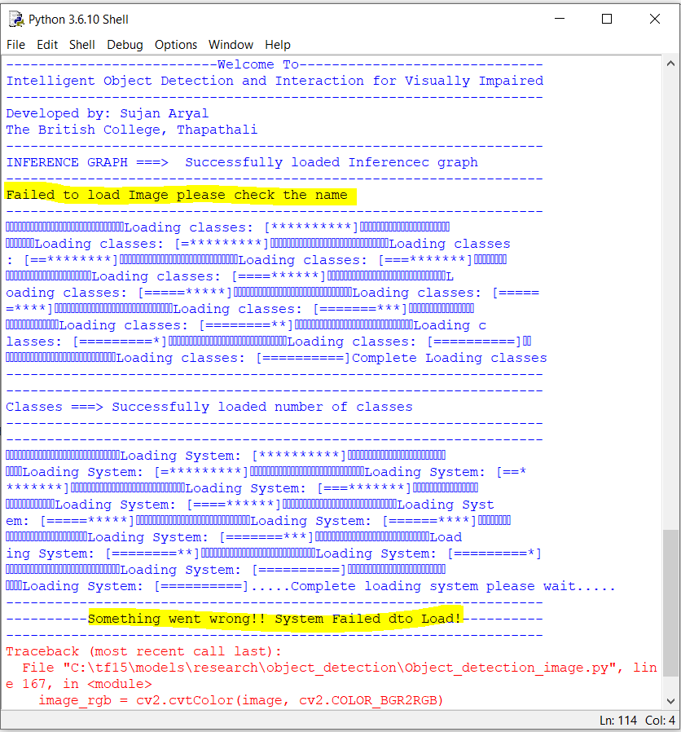
Testing the product
Testing running successful

Slide 21

How does AI System Works?
Image Label
CNN Models (Neural Network)
Datasets
Requires Hardware Devices
Training
Train and Test Record
Frameworks/Libraries

Slide 22

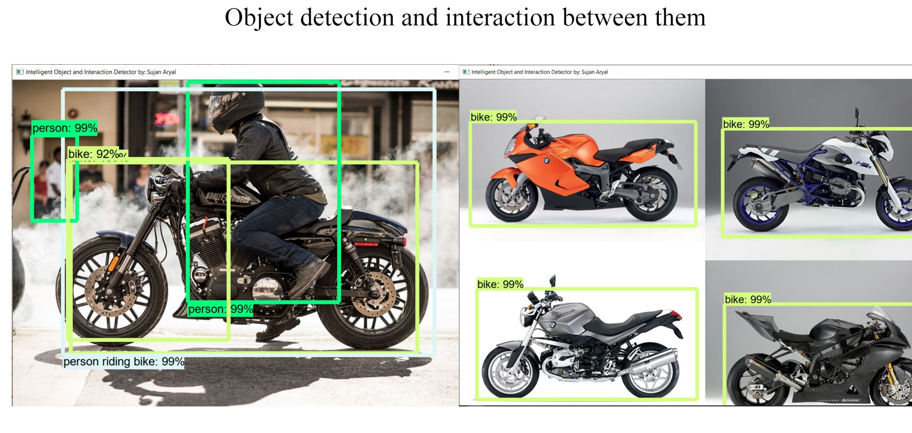
Python App
Intelligent Object Detection and Interaction for Visually Impaired.
Detects objects as well as interactions between them.

Slide 23
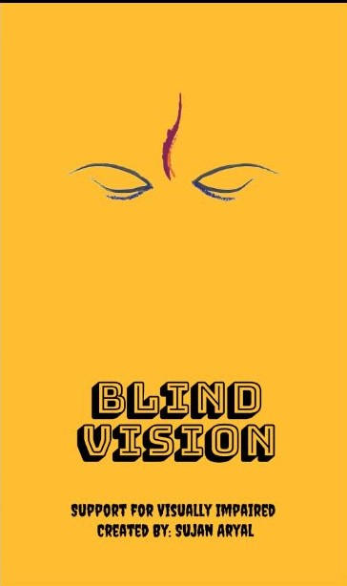
MOBILE APP
Blind Vision App – Assistance to the Visually Impaired
Real time object detection with voice feedback.

Slide 24


Project Demo

Slide 25
Future Improvments
Future Work:
- GUI for Python App.
- More meaningful Dataset.
- Voice commands in Android app.
- Text to speech in Python App.
- More User friendly Design.

Slide 26
Learning from Project
To conclude, I learned about AI Systems and ways to implement it in the project. After doing research, I learned about problems faced by blind people as well as other impaired people as well. And helping such people with AI technology is good way of implementing such technology.
Things I learned about:
- Tensorflow, OpenCv and open source Libraries.
- Idea for making another AI systems to aid different people.
- Useful simple Algorithms with if else.
- Android apps and it’s activities.
- Text to Speech implementation and it’s uses.

Slide 27
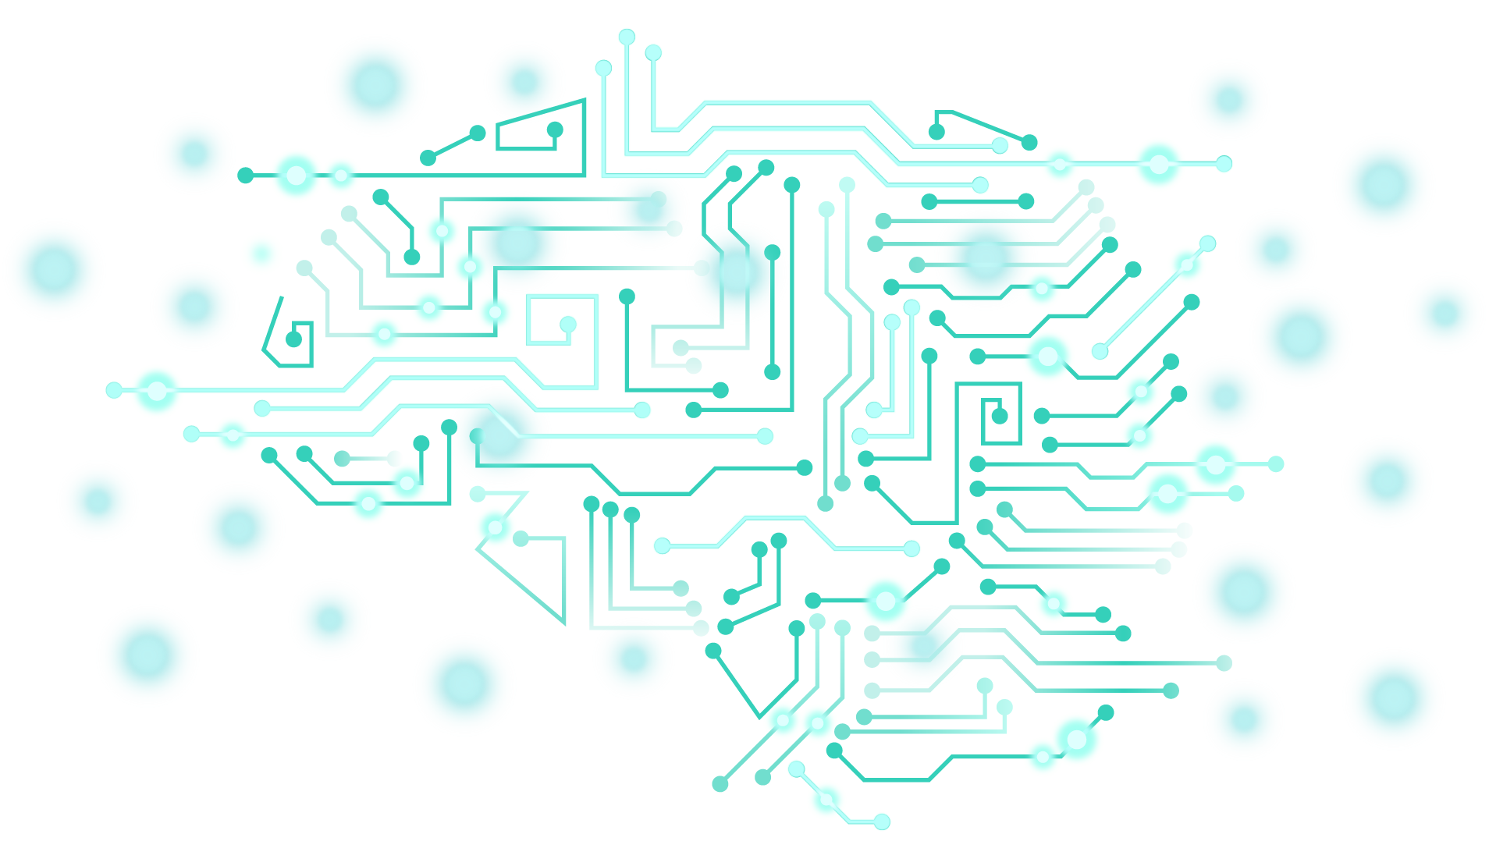
THANKS!
Any questions?
sujanaryal000@gmail.com
Std id: 77190077
Intelligent Object Detection and Interactions for Visually Impaired
Designed for Visually Impaired

